Slide 1

CSC 2302/DSCI 1302 Debugging
- S M Towhidul Islam

Slide 2
Debugging
Identifying and fixing errors or bugs in a program
PyCharm Official Documentation:
Debug your first Python application | PyCharm Documentation (jetbrains.com)

Slide 3

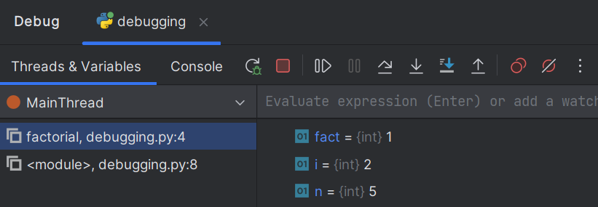
Debugging with PyCharm
Set some breakpoints
Click on debug “your_program_name”
PyCharm starts a debugging session and shows Debug tool window
Step over
resume
Step Into
Step Out
variables

Slide 4
Demonstration
A simple lottery game
-201 participants
-Need to randomly select 3~5 winners
-Determine each winner as follows:
- Choose two random numbers between 0 to 100
- Add these two numbers and get the winner
- Note: 0 <= winner <= 200

Slide 5
Setting Breakpoint(s)
import random def get_winner(): rand_a = random.randint(0, 100) rand_b = random.randint(0, 100) res = rand_a + rand_b return res n = random.randint(3,5) winners = [] for i in range(1,n): winner = get_winner() winners.append(winner) print(winners)
Breakpoint

Slide 6
Resume Program
Allows the program to run from the current breakpoint until the next breakpoint
import random def get_winner(): rand_a = random.randint(0, 100) rand_b = random.randint(0, 100) res = rand_a + rand_b return res n = random.randint(3,5) winners = [] for i in range(1,n): winner = get_winner() winners.append(winner) print(winners)
Resume
Resume

Slide 7
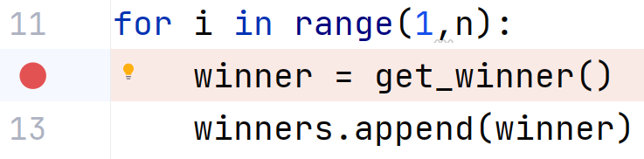
Step Over
Executes the current line of code and then move to the next line in the program
The debugger will treat a function call as a single step
Step Over

Slide 8
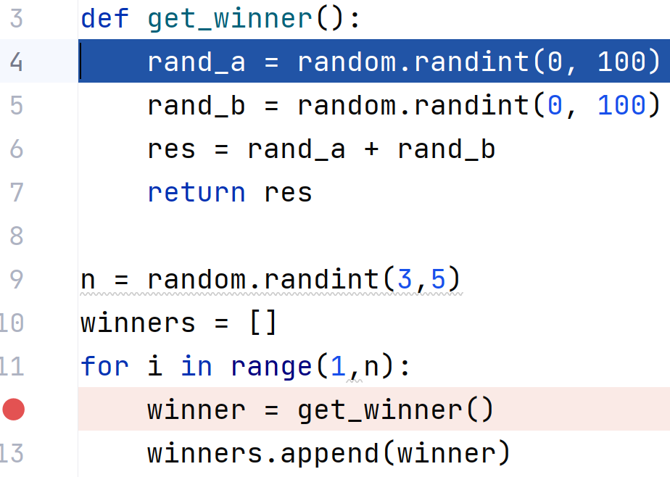
Step Into
The debugger will dive into the details of a function call
Step Into

Slide 9
Step Out
Used to quickly exit the current function or method and return to the caller
Step Out

